Slide 1
CPU Scheduler Demo
Devine Chinemere & Kamal Epps

Slide 2
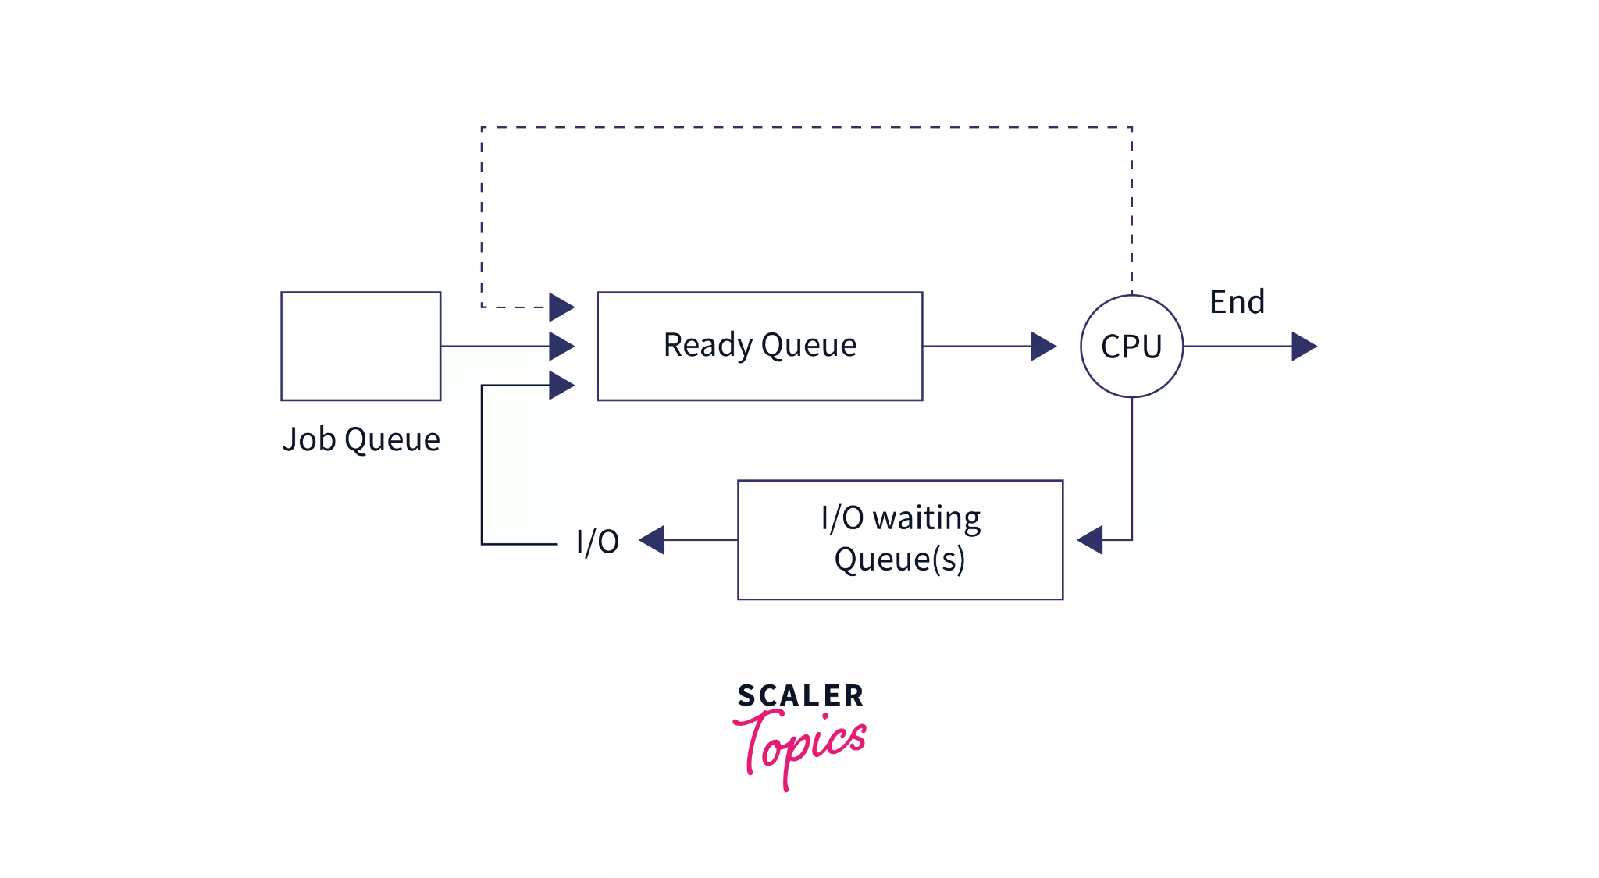
What is a CPU Scheduler?
A CPU Scheduler decides the order of process execution on the CPU.
Some key parts of this are :
Waiting Time: Time spent waiting in the ready queue.
Turnaround Time: Total time from process arrival to completion.
Response Time: Time from process arrival to first CPU execution.
Our Goals were to:
Implement Round Robin Scheduling.
Simulate real-time execution of processes

Slide 3
Program Design
For our program we decided to design each class with a specific task in mind
Process class:
Represents a task with attributes (e.g., id, arrival Time, burst Time).
Scheduler interface:
Base class for scheduling algorithms
Round Robin Scheduler class:
Derived from Scheduler to simulate Round Robin logic.
Handles processes in fixed quantum time slices.

Slide 4
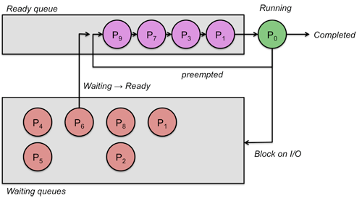
Round Robin Algorithm
Processes are added to the ready queue when they arrive
Each process gets executed for a fixed quantum (ex: 4 units).
The scheduling algorithm then allocates equal time slices to all processes.
Each process is re-queued, if it doesn’t finish within its time slice.
Context switching occurs between each processes in our queue
Simulation time progresses until all processes in the queue are complete

Slide 5
Simulation Results
When our algorithm finishes, we should expect the results below
Waiting Time: Total time spent in the ready queue.
Turnaround Time: Total time from arrival to completion.
Response Time: Time until first execution
From this we can see:
That all processes get a fair share of our fake CPU
How turnaround time is affected by arrival and burst times

Slide 6
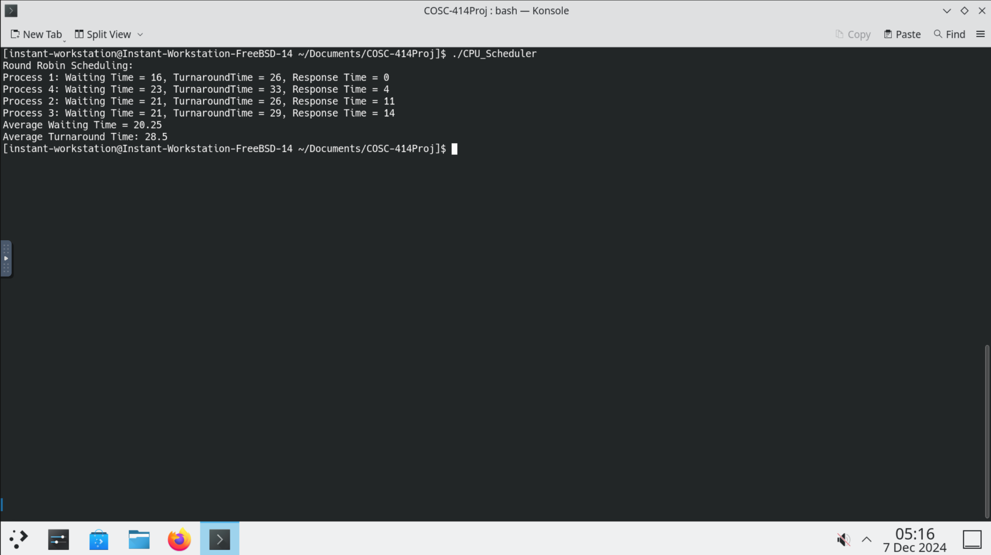
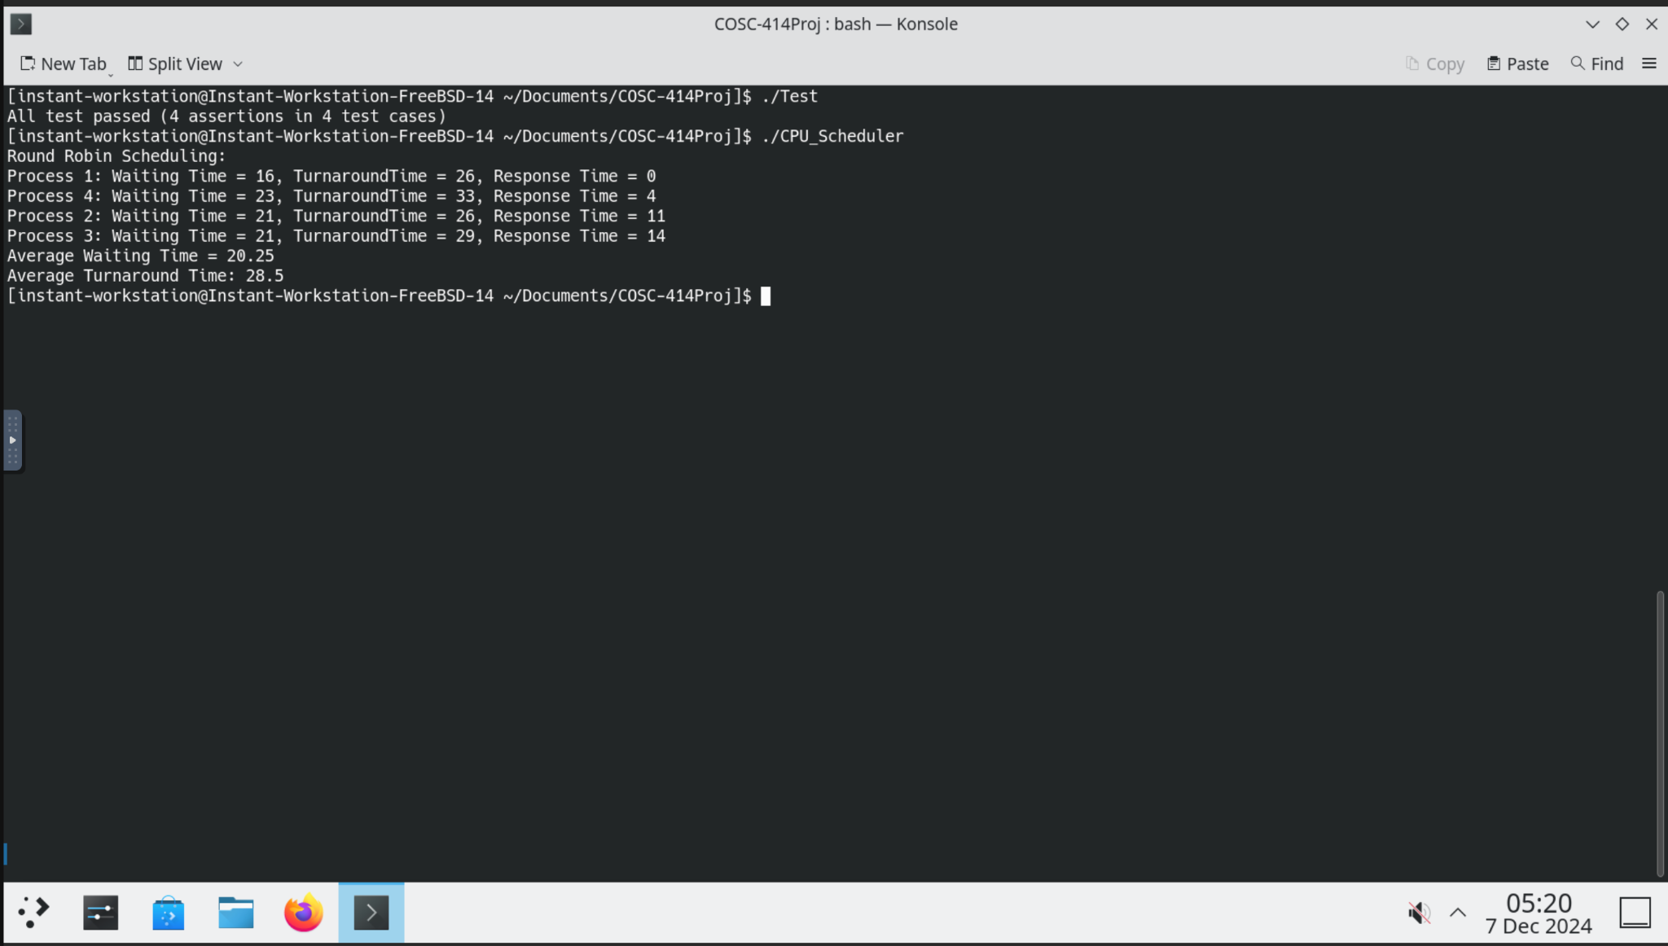
Examples of code execution

Slide 7
CODE WALK THROUGH TIME!!!

Slide 8
Sources
https://www.geeksforgeeks.org/program-for-round-robin-scheduling-for-the-same-arrival-time/
https://www.scaler.com/topics/operating-system/cpu-scheduling/
https://people.cs.rutgers.edu/~pxk/416/notes/07-scheduling.html
https://www.youtube.com/watch?v=aWlQYllBZDs

